Slide 1
Tung Thien Vuong Secondary School
Teacher: Nguyễn Thành Nhân
Class: 6/1

Slide 4
What is the name of the movies?

Slide 5
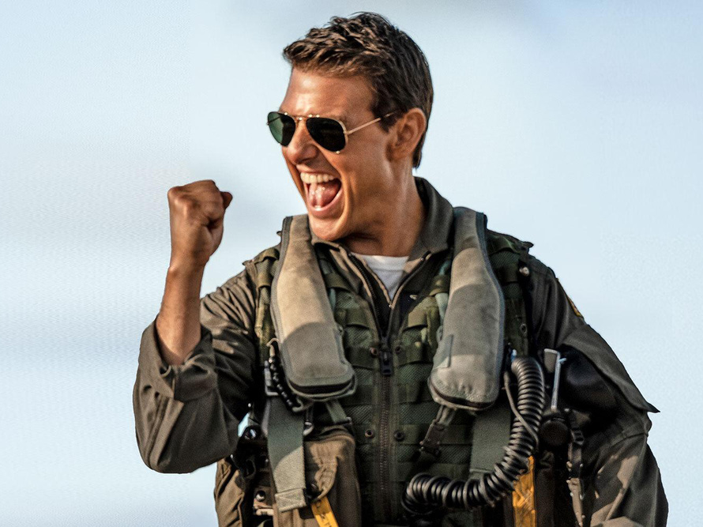
1. Top Gun: Maverick

Slide 6
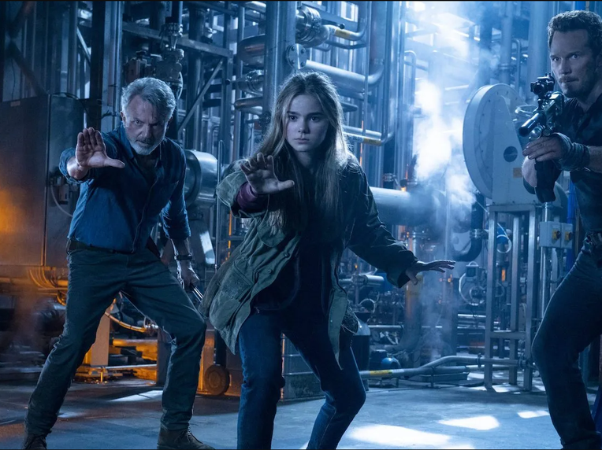
2. Jurassic World Dominion

Slide 7
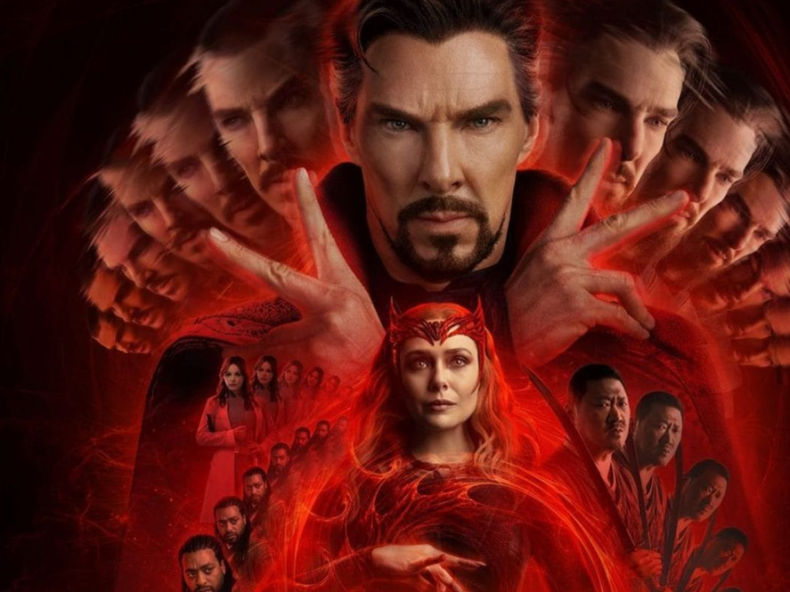
3. Doctor Strange in the Multiverse of Madness

Slide 8
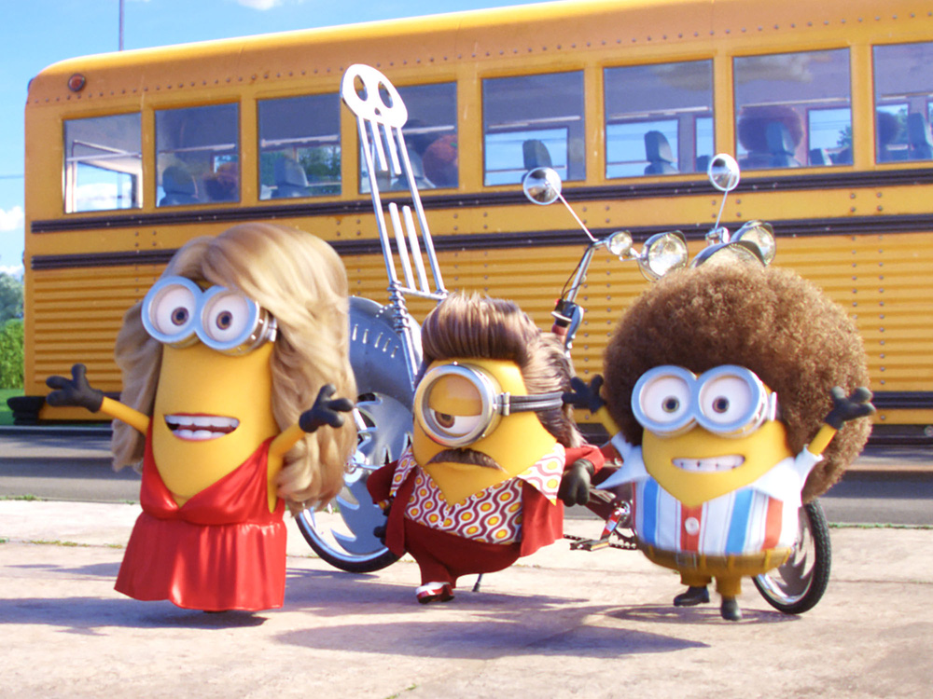
4. Minions: The Rise of Gru

Slide 9
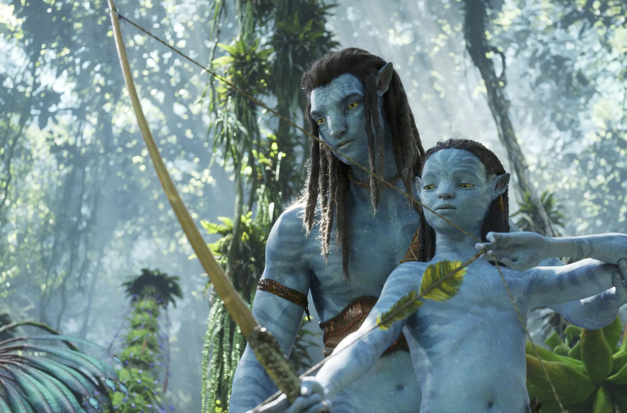
5. Avatar: The Way of Water

Slide 10
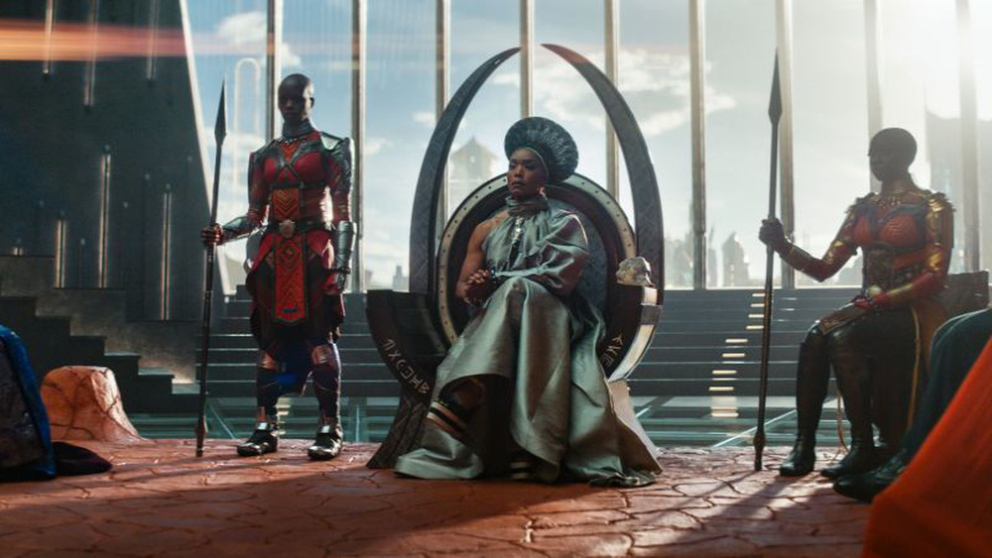
6. Black Panther: Wakanda Forever

Slide 11
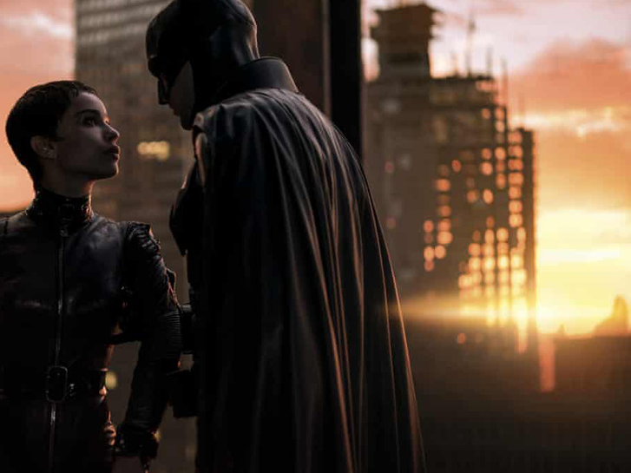
7. The Batman

Slide 12
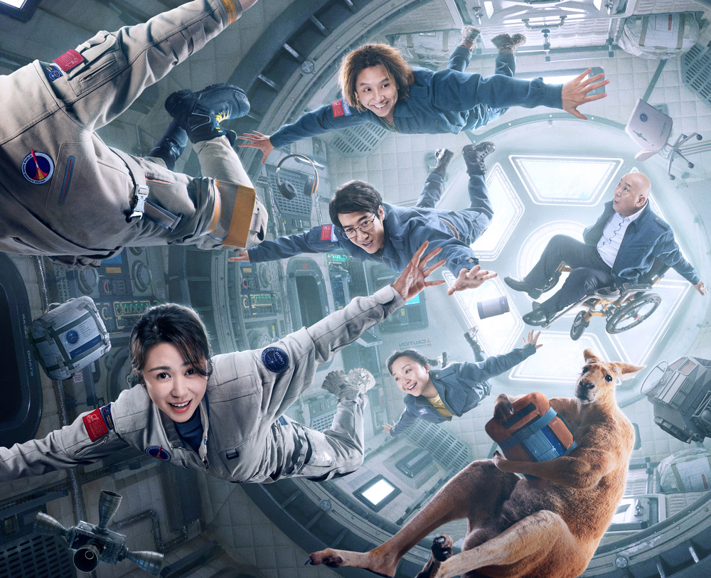
8. Moon Man

Slide 13
Friday, March 10th 2023
Unit 7
MOVIES
Lesson 3 – Page 61

Slide 14
Lesson 3
army
king
invaders
soldiers
battle

Slide 15
Lesson 3
army
king
invaders
soldiers
battle

Slide 16
Lesson 3
Work in pairs, take turn to introduce the movies to each other.
Example:
This is Trung Vuong (She-Kings) movie. It’s a historical movie about Trung Sisters: Trung Trac and Trung Nhi – Vietnamese female generals. They were born in around 1st century. Trung Trac became a queen in the year of 40. They’re famous for winning many battles against invaders.

Slide 17
Lesson 3

Slide 18
Lesson 3

Slide 19
HOMEWORK
Write a paragraph (50-60 words) about the short movie review of the historical film you like best.
Prepare the next lesson: Unit 8 – Lesson 1.

